Slide 1
CAPSTONE PROJECT FOR CONSTRUCTING A SYNTAX TREE
Submitted by
S. CHENCHU DANUSH (192211615)
P. CHANDU (192211204)
Under the Supervision of
Dr. W. Deva priya

Slide 2
ABSTRACT:
The capstone project aims to develop a comprehensive software system capable of parsing source code and constructing a syntax tree, a fundamental component in the analysis and compilation of programming languages. The system will employ routines to build a tree data structure that represents the syntactic structure of given source code. This involves defining node types for various language constructs, including expressions, statements, declarations, and control flow constructs. The project will also design and implement algorithms to traverse the parse tree and construct the syntax tree accurately. By providing a detailed representation of the syntactic structure, this system facilitates further tasks such as semantic analysis, code optimization, and error detection, contributing significantly to the field of compiler construction and language processing.

Slide 3
INTRODUCTION:
The construction of a syntax tree is a critical step in the compilation process of programming languages. A syntax tree, or abstract syntax tree (AST), is a hierarchical tree representation of the abstract syntactic structure of source code. Each node in the tree denotes a construct occurring in the source code. The primary goal of this project is to develop software that can parse source code and accurately construct a syntax tree, thus providing a clear and structured representation of the code’s syntax.
In this project, we will focus on designing and implementing routines to build a tree data structure that captures the syntactic elements of the source code. This involves defining various node types to represent different language constructs such as expressions, statements, declarations, and control flow elements. These node types are essential for capturing the diverse syntactic components of a programming language.

Slide 4
The construction of the syntax tree will be based on traversing a parse tree generated by a parser. The parser processes the source code and creates a parse tree, which includes all the syntactic details according to the grammar of the programming language. The syntax tree, on the other hand, abstracts away some of the syntactic details to focus on the structure and content relevant to the language's semantics.
This project will not only deepen our understanding of compiler construction and language processing but also provide practical tools for further development in areas such as semantic analysis, code optimization, and automated error detection. By the end of the project, we aim to deliver a robust software system that can serve as a foundational component in the development of compilers and other language processing tools.

Slide 5
PROBLEM STATEMENT:
The objective of this capstone project is to design and implement software that parses source code and constructs a syntax tree, accurately representing the syntactic structure of the code. This involves defining node types for various language constructs—such as expressions, statements, declarations, and control flow constructs—and developing algorithms to traverse the parse tree to build the syntax tree. The resulting syntax tree will facilitate semantic analysis, code optimization, and error detection, serving as a critical component in compiler construction and language processing.

Slide 6
FUNCTIONALITY:
• Source Code Parsing:
Develop routines to parse source code written in various programming languages.
Implement a lexer to tokenize the input source code into meaningful tokens.
Design a parser to generate a parse tree representing the syntactic structure of the source code.
• Syntax Tree Construction:
Define node types to represent different language constructs such as expressions, statements, declarations, and control flow constructs.
Develop algorithms to traverse the parse tree and construct a syntax tree based on the defined node types.
Ensure accuracy in capturing the syntactic structure of the source code through the syntax tree representation.

Slide 7
• Node Representation:
Define appropriate data structures to represent nodes in the syntax tree, capturing essential information such as node type, value, and child nodes.
Design node classes or structures tailored to specific language constructs, ensuring clarity and consistency in representation.
• Traversal Algorithms:
Implement traversal algorithms such as depth-first or breadth-first traversal to navigate the parse tree and construct the syntax tree.
Develop mechanisms to handle nested constructs and establish hierarchical relationships between nodes.

Slide 8
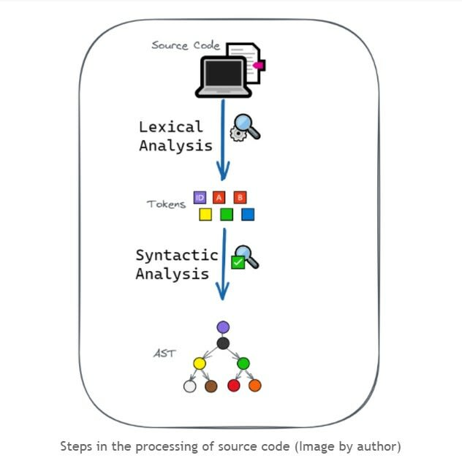

Slide 9
Methodology:
Developing a capstone project for constructing a syntax tree involves designing software that can parse source code and construct a tree representation of its syntactic structure. The methodology begins with selecting the target programming language and the tools for parsing and syntax tree construction, such as ANTLR or PLY. The next step is defining the grammar of the target language using a formal grammar description like BNF or EBNF. Following this, a parser is implemented to convert the source code into a parse tree. To represent different language constructs, various node types are defined, including nodes for expressions, statements, declarations, and control flow constructs.

Slide 10
TRAVERSAL ALGORITHM:
Traversal algorithms are fundamental techniques used to visit and process nodes in a tree data structure. In the context of constructing a syntax tree from a parse tree, traversal algorithms are crucial for systematically exploring the parse tree and building the corresponding syntax tree nodes.
Depth-First Traversal (DFT)
Start at the Root Node
Visit Each Child Node Recursively
Construct Syntax Tree Nodes
Add Child Nodes to Parent Nodes
Return Syntax Tree Root NodeContinue Traversal Until Completion

Slide 11
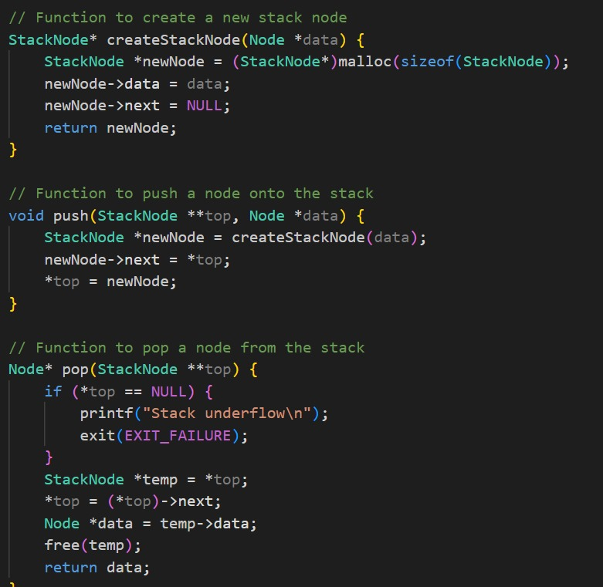
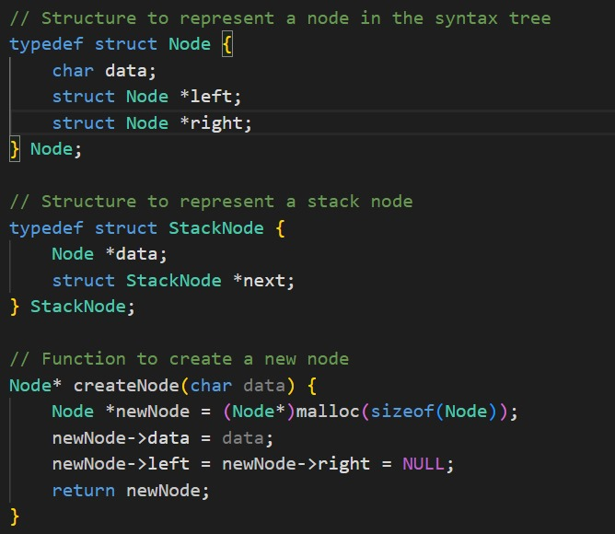
Result and Analysis:

Slide 12
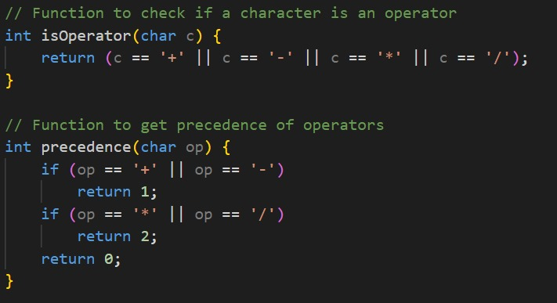
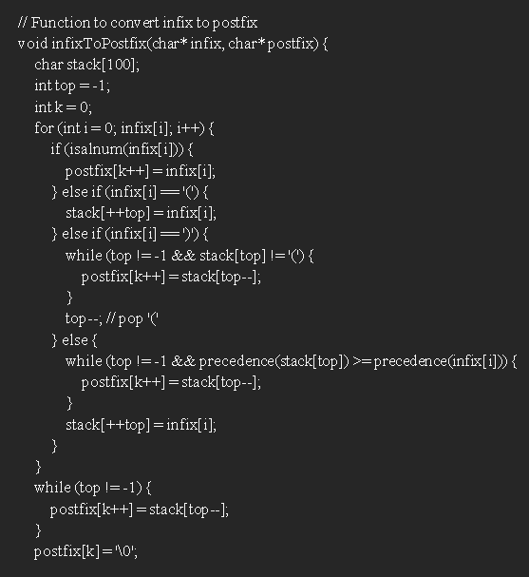
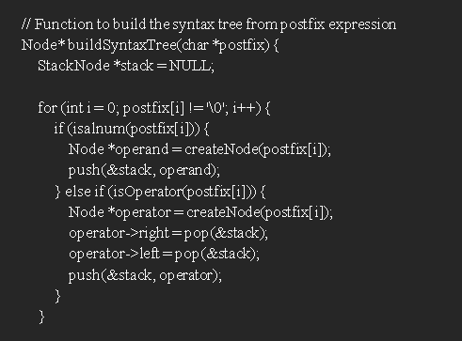

Slide 13
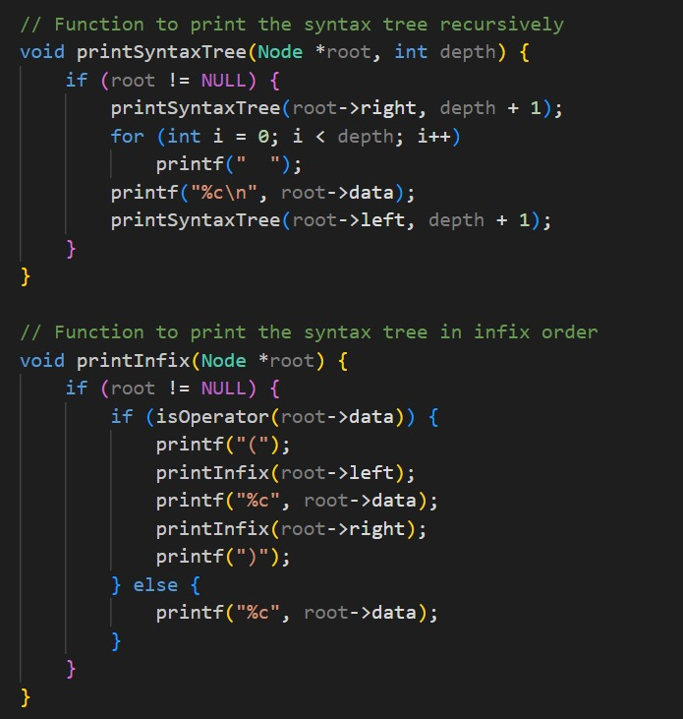
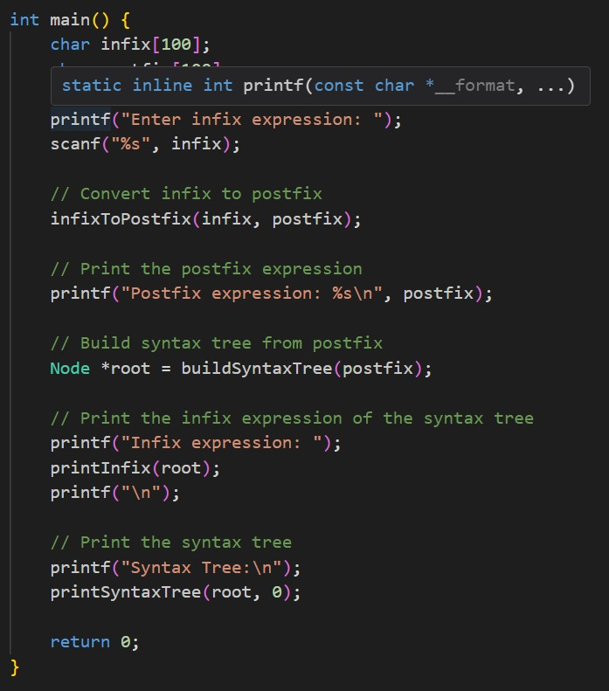
Result and Analysis:

Slide 14
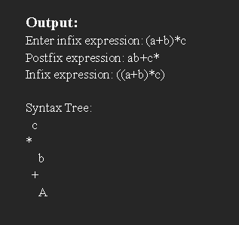
OUTPUT:

Slide 15
Challenges and future work:
The project faces several challenges, including handling complex and ambiguous grammars, ensuring the efficiency and scalability of the parser and tree construction algorithms, and seamlessly integrating machine learning models with traditional parsing techniques. Future work will focus on extending the methodology to support multiple programming languages, implementing more advanced code analysis and optimization techniques using machine learning, and developing real-time syntax tree construction tools for interactive development environments.
Conclusion:
In conclusion, the capstone project successfully demonstrates the ability to design and implement a system for constructing syntax trees from source code. The project not only covers the core aspects of parser design and tree construction but also incorporates performance analysis and visualization tools. The integration of machine learning enhances the system's capabilities in error detection, correction, and code optimization. Future work aims to expand the system's language support and incorporate more advanced analysis techniques, paving the way for the development of more intelligent and efficient programming tools.

Slide 16
BIBILIOGRAPHY
Penev I, Karova M. Implementation of a Training Parser Using Explicit Abstract Syntax Tree. InProceedings of the 20th International Conference on Computer Systems and Technologies 2019 Jun 21 (pp. 299-303).
Baxter, Ira D., et al. "Clone detection using abstract syntax trees." Proceedings. International Conference on Software Maintenance (Cat. No. 98CB36272). IEEE, 1998.
Allen, Eric, et al. "Growing a syntax." Proceedings of Workshop on Foundations of Object-Oriented Languages. 2009.
Falke, Raimar, Pierre Frenzel, and Rainer Koschke. "Empirical evaluation of clone detection using syntax suffix trees." Empirical Software Engineering 13 (2008): 601-643.
Derrick, Donald, and Daniel Archambault. "TreeForm: Explaining and exploring grammar through syntax trees." Literary and linguistic computing 25.1 (2010): 53-66.
Crew, Roger F. "ASTLOG: A Language for Examining Abstract Syntax Trees." DSL. Vol. 97. No. 18. 1997.

